Slide 1
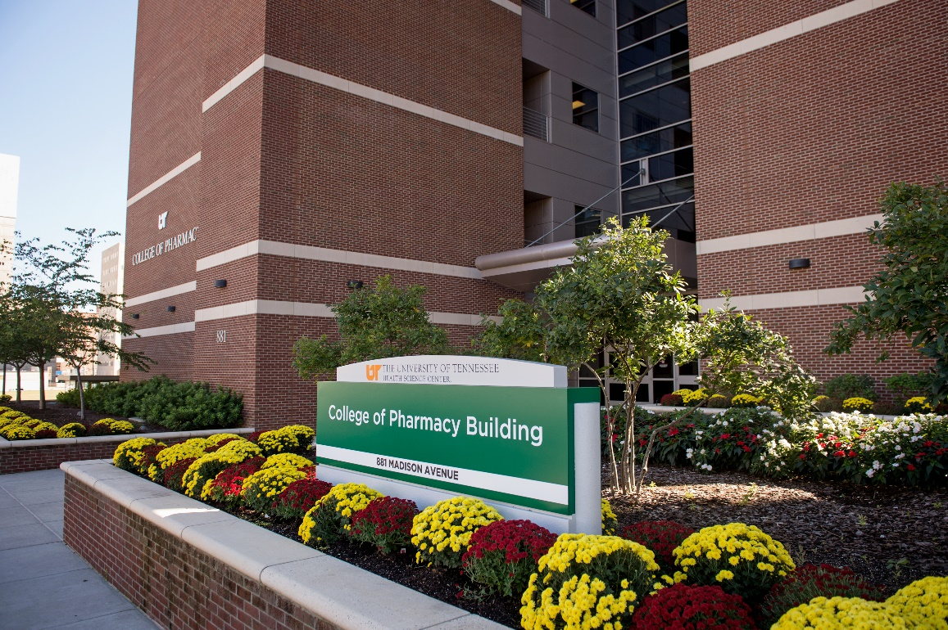
College of Pharmacy
Marie Chisholm-Burns, PharmD, MPH, MBA, FCCP, FASHP, FAST
Dean and Professor

Slide 2
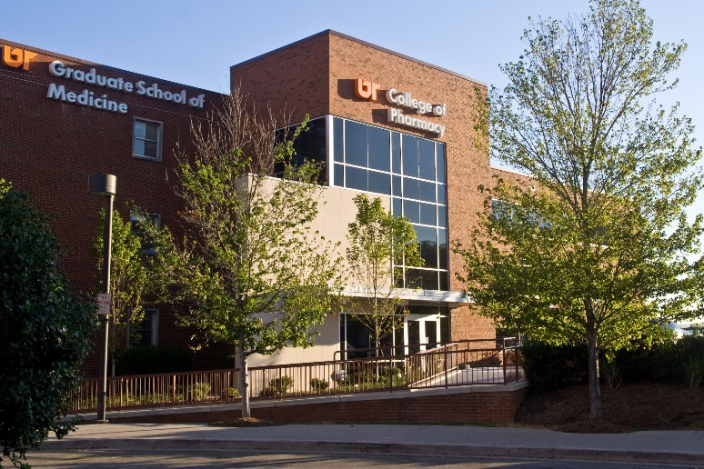
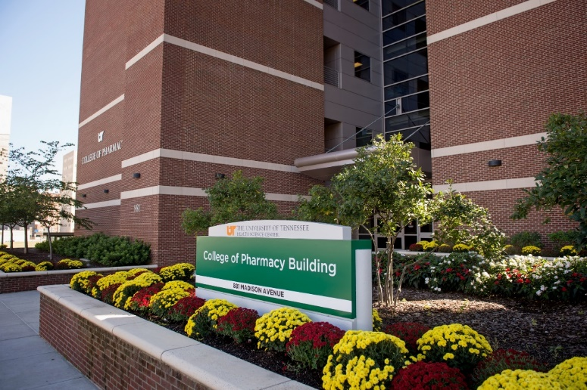
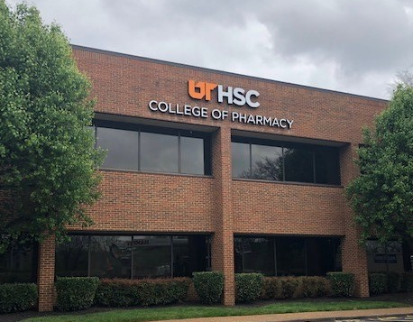
Knoxville Campus
1924 Alcoa Highway Box 117
Knoxville, TN 37920
Memphis Campus
881 Madison Avenue
Memphis, TN 38163
Nashville Campus
301 S. Perimeter Park Dr., Ste. 220
Nashville, TN 37211

Slide 4
In-State Tuition | Out-of-State Tuition
$22,170.00 | $27,172.50

Slide 5
TOP QUALITY

Slide 6
NAPLEX* First-Time Pass Rate
*North American Pharmacist Licensure Examination®

Slide 7
MPJE* First Time Pass Rate
*Multistate Pharmacy Jurisprudence Examination
Notes:
MPJE:
UT -> 91.44% (all states); 90.7% (TN only)
State MPJE -> 83.07%
National MPJE -> 83.76%

Slide 8
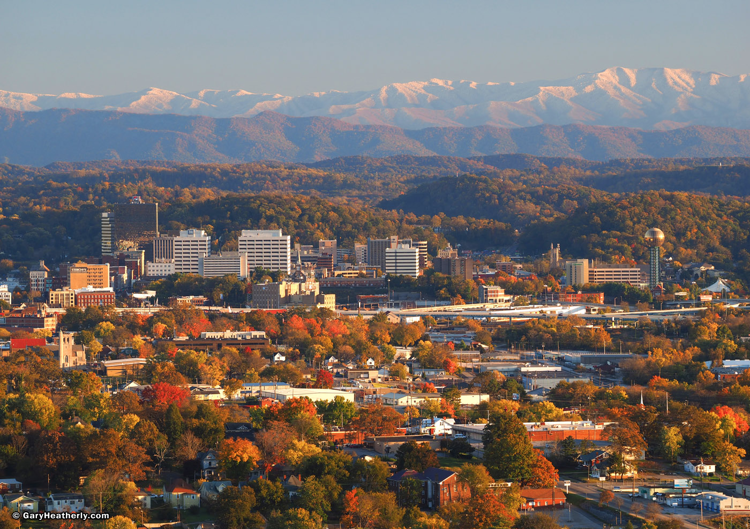
Dual Degree & Certificate Initiatives
Dual PharmD/Masters in Business Administration
Dual PharmD/Masters in Health Informatics and Information Management
Dual PharmD/PhD
Dual PharmD/Masters in Public Health
Certificates: Health Informatics and Information Management, Nuclear Pharmacy, Medication Therapy Management, Immunization Delivery, Point of Care Testing
Notes:
MHIIM=Master of Health Informatics and Information Management
The following data was provided by Sean (he says information may be updated week of 9/25, he is waiting to hear back from informatics office):
Completed MHIIM: 3 in Class of 2017
Completed informatics certificate: n=9
4 in Class of 2016
2 in Class of 2017
2 in Class of 2018
1 in Class of 2019
Completed MBA: n=9
2 in Class of 2015
5 in Class of 2016
2 in Class of 2017

Slide 9
AACP - Total NIH Funding (including Co-PI & subawards): Amount by Federal Fiscal Year

